Slide 1
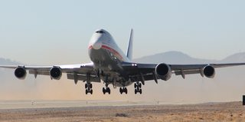
Regional Company Career Exploration Snapshot
Contact Cory Wright (585) 678-1265 or cory_wright@boces.Monroe.edu If you have questions about this template or other items
service
Advanced Atomization Technologies (AA TECH)
Advanced Atomization Technologies designs, produces, and supports fuel nozzles for some of the most powerful and efficient GE, CFM, and Engine Alliance gas turbine engines in the world. The company is uniquely competitive with design, assembly, test, and aftermarket support capabilities.
Notes:
Thank you for helping us connect students with regional organizations. This career exploration resource will serve as a catalyst and gateway to deeper exploration. This may include live virtual Q/A with your organization; a virtual tour of your work environment; and participation in career fairs and interviewing opportunities.
This Powerpoint is a flexible template to begin collecting insightful information and visuals to help education K12 students about local career opportunities.
Please share your companies story answering the questions with words and pictures.
Just click in the slide and add your details
Feel free to add or subtract questions as needed.
We will edit and shape once we have you information
See this Company Career Exploration template as a starting point we will collaboratively develop and update as needed
Contact Cory Wright (585) 678-1265 or cory_wright@boces.Monroe.edu If you have questions about this template or other items
This format will allow us to share your story in a variety of ways to best engage and inspire students
As always, we are open and flexible to new ideas and approaches
The MONROE ONE BOCES School to Career Service is focused on efficiently connecting the K12 Educational Community with regional organizations to strengthen education and our future workforce. Please reach out so see how we might support you.

Slide 2
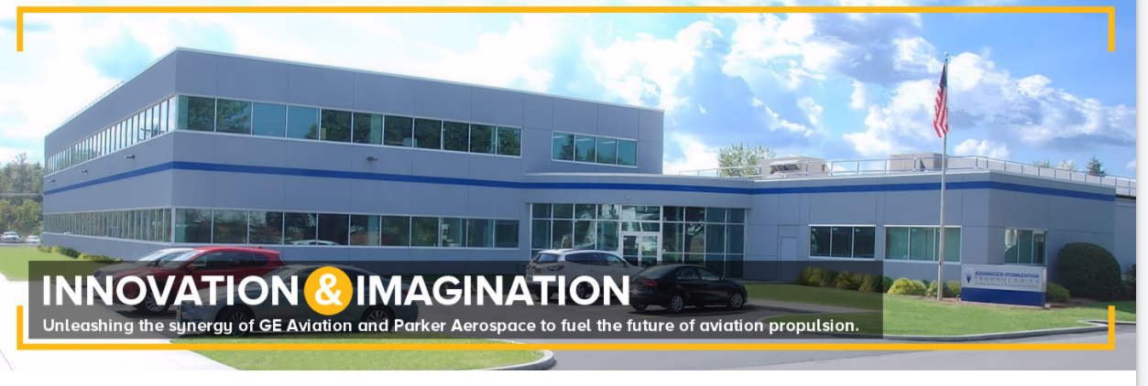
Advanced Atomization Technologies (AA TECH)
Location: Clyde, NY
About how many people do you employ? 240
Current Jobs/roles in demand?
Machinists
Mechanical Engineer
Other Career Opportunities
Assembler
Production associate
Stick, MIG, and TIG welder
Machine operator ▪ Quality engineer
Manufacturing engineer ▪ Design engineer

Slide 3
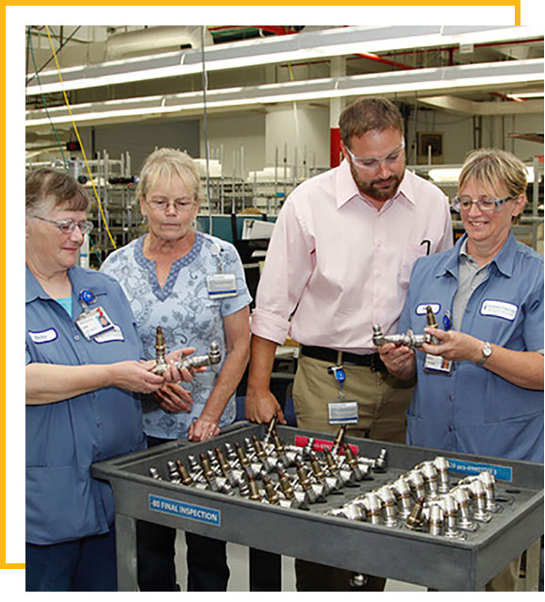
Contact Cory Wright (585) 678-1265 or cory_wright@boces.Monroe.edu If you have questions about this template or other items
What are the skills or characteristics you look for when hiring? What gets someone hired or fired?
Desire to learn
Showing up on time
SEE VIDEO CLIP
What are some of the benefits for your employees?
College Tuition Assistance
Student loan repayment assistance program
Health and Retirement Benefits
Inclusive work environment

Slide 4
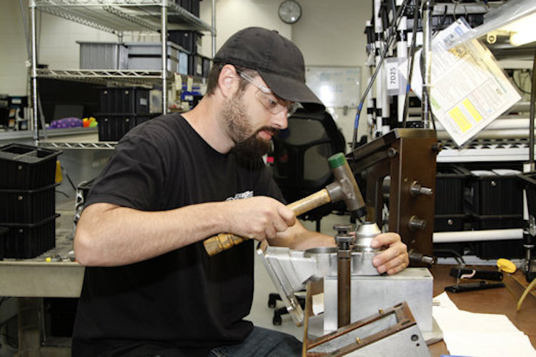
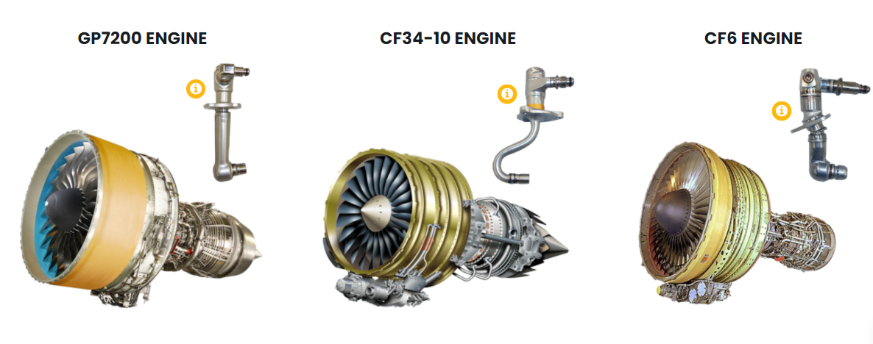
Career entry-point Opportunities
Entry Level | Middle Skills Certificate; Apprentice Training | 2 Yr College Training or Experience | 4 Yr + College Training
-- In Demand --
Assembler | Welders Machine Operators Machinist 1 Machinist 2 Machinist 3 | Engineering Tech | Engineering Mechanical
Other Career Opportunities in Finance, Supply Chain, Quality
NYS Apprenticeship
Opportunities
Possible Career Path

Slide 5
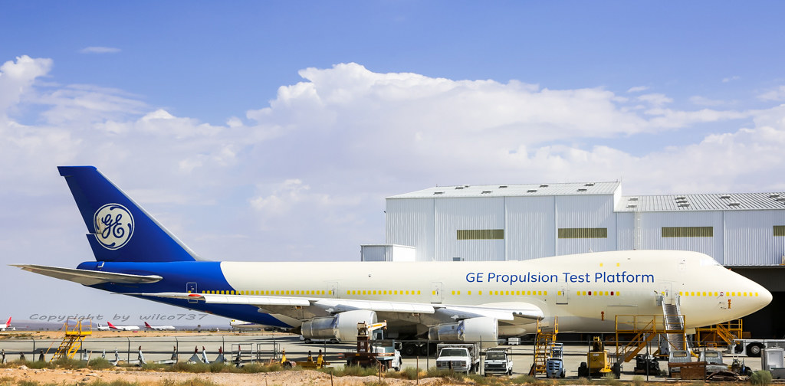
Career Path Stories
https://advancedatomization.com/careers/
Assembler and beyond
CPT Training
Assembler
Machinist 1
Machinist 2
Story: In only 2 years time, John Temp, climbed his career ladder to a Machinist 1. John started working at AA Tech as a Temp Worker in the role of an Assembler. In his first 3 months he his process flow was better than all of the Assemblers. Recognized for his strong performance, John was hired as a full-time Assembler and quickly learned and was promoted to a Machinist 1.
His future is bright with Machinist 3 and Engineering Tech in his future.
Assembler
Group Leader
Production Supervisor
Operations Team Leader
Value Stream Leader
Value Stream Leader
Story: One of our Value Stream Leaders began with us as a co-op. After being hired as a Manufacturing Engineer, she was diligent in her work and currently works in a position responsible for 110 team members and the efficient and timely production of quality parts for our customers.

Slide 6
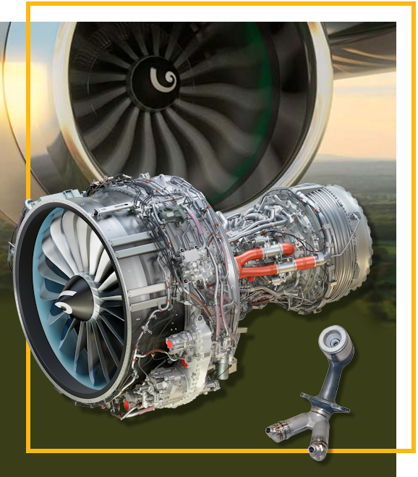
Machinist
Contact Cory Wright (585) 678-1265 or cory_wright@boces.Monroe.edu If you have questions about this template or other items
Job / Role Spotlight
What does a work day look like for this role? Team meeting, operate machine, test parts, gage parts
Primary work task/activities/skills? Converts raw materials into finished parts using a machine.
Typical hours, Work Shift options and overtime? Two shifts ( 6pm – 2pm) (2:30pm-10:30pm)
What training do you offer for this job/role?
Offer on-the-job training for all operations positions

Slide 7
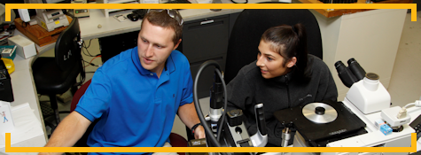
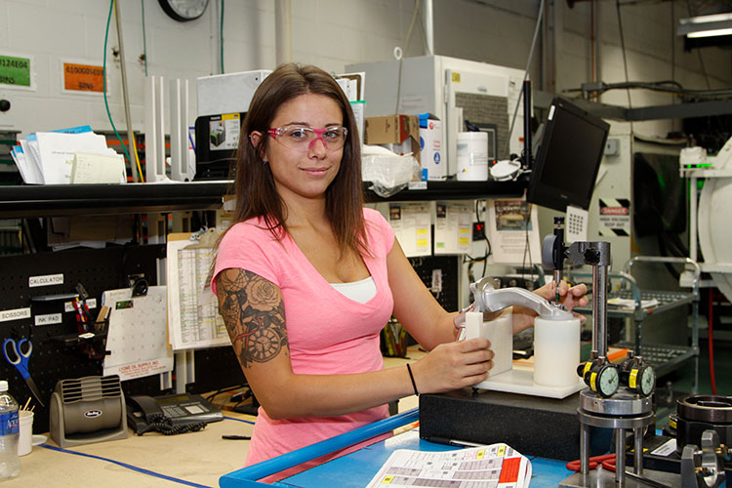
What else should people know?
Are you a fit for AA TECH?
Do you enjoy designing and looking at concepts?
Are you curious about how things work and how to make them work better?
Do you have a practical and logical mind and enjoy being hands-on in your job?
Why talented professionals join AA TECH
Stability: our industry is strong and growing rapidly
Growth: We have regular opportunities for advancement and excellent benefits
Involvement: We work together to make improvements to our products and our workplace
Mission: Our products are critical to the global aerospace industry

Slide 8
Join the LIVE conversation with AA TECH
Advanced Atomization Technologies (AA TECH)
WHEN: January 20th TIME: 10:30 am
WHERE: Virtual Microsoft Team Meeting
WHO: WHY:
Dr. Richard Hill, AA TECH (Engineer, Manager, Talen Scout)
Cory Wright, School / Business Partnerships (Facilitator)
Hear about new career opportunities
Discuss work trends and career paths
Ask questions
Get the “Need to know” information
For more information about the Live conversation email cory_wright@boces.Monroe.edu

Slide 9
LIVE & VIRTUAL Company / Career Snapshot Events
Read, Watch, and Talk with area expert during these 1hr events
Event Calendar:
January 20th | Advanced Atomization Technologies FOCUS: Middle Skills, Machinist, Engineering
February 10 th | Healthcare Opportunity: Respiratory Care FOCUS: High need field, with experts from field and GCC cert. program
March TBD | JML Optics FOCUS: Middle Skills, Apprentice Program, Engineering
March TBD | TBD - (Video game design, Law, ?)
Students pique curiosity, insights, and career focus while:
Exploring the Career Snapshot Resource before the live event
Learn about the company and or career
Watch the short video highlights
Capture your curious questions for the live session
Participating in the Live Question and Answer Session
Hear from the experts
Find answers to your questions
Learn career insights you didn't know
Make a networking connection and more

